Slide 1



Used Car Price
Prediction
Group Members:
Jin-Hyuk Son
Julio Montoya
Vaijayanti Deshmukh

Slide 2
Agenda
00 | RESEARCH QUESTIONS
01 | OVERVIEW OF DATA
02 | DATA PREPROCESSING
03 | EXPLORATORY DATA ANALYSIS
04 | MODEL BUILDING TECHNIQUES
05 | FEATURE IMPORTANCE
06 | CONCLUSION

Slide 3
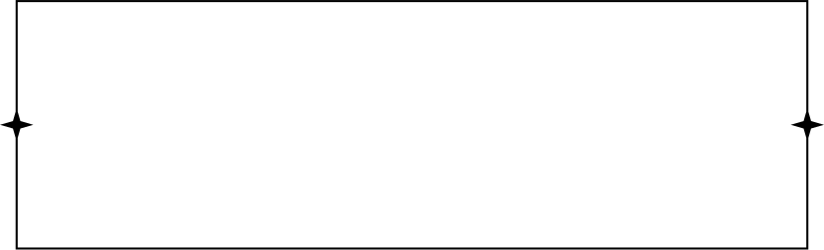
Research Questions
This research explores the used car prices prediction considering different features such as mileage, brand, model, year and others. Some of the questions explore are:
How do car model year, mileage, and engine size impact used car prices?
To what extent does car brand affect resale price?
What factors are most influential in predicting used car prices?
Can we segment used cars into meaningful clusters based on their pricing-related features?
Notes:
Barath

Slide 4

Overview of Data
Originally sourced from the automotive market place website www.cars.com.
Roughly 188,500 observations which includes features such as:
Brand
Model
Year
Mileage
Fuel
Engine
Transmission
Interior color
Exterior color
Accident
Clean title
Notes:
Barath

Slide 5
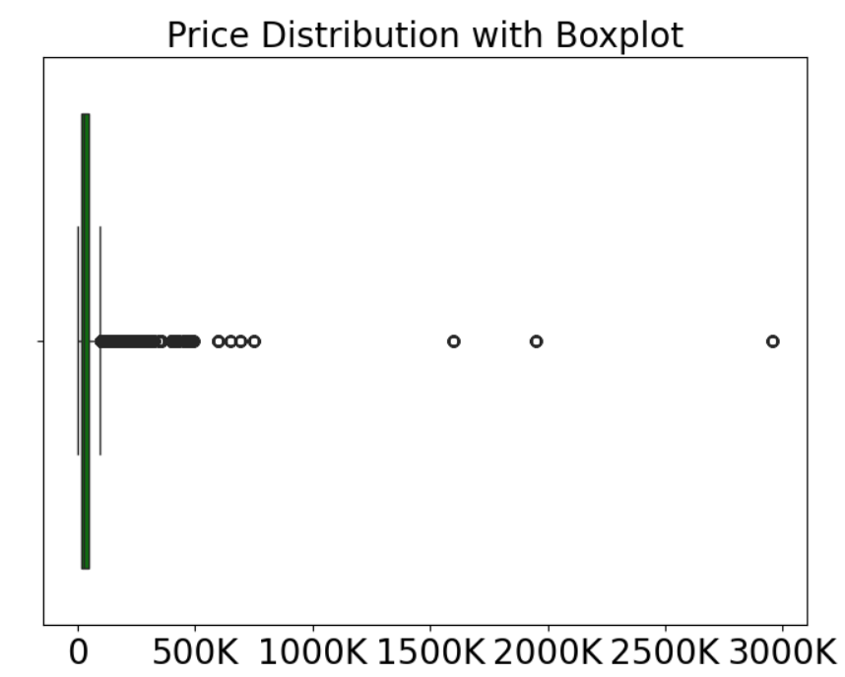
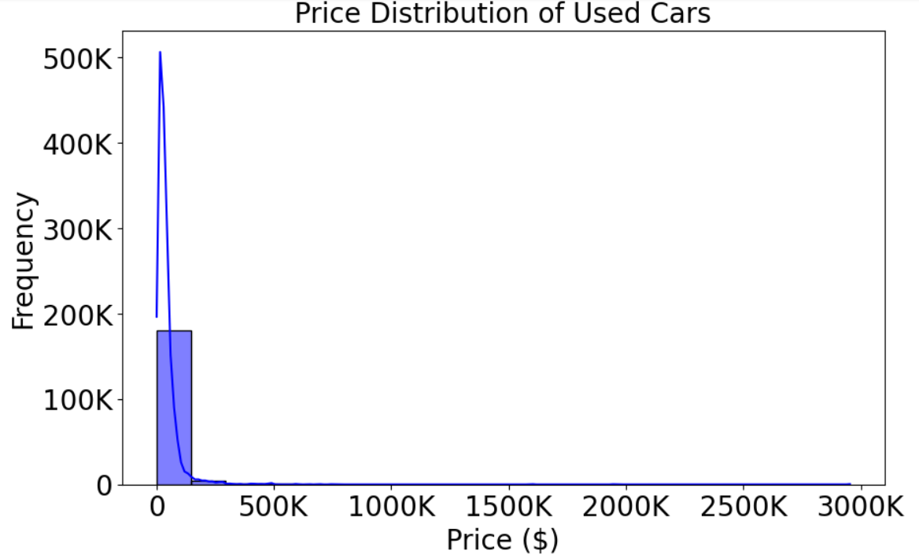
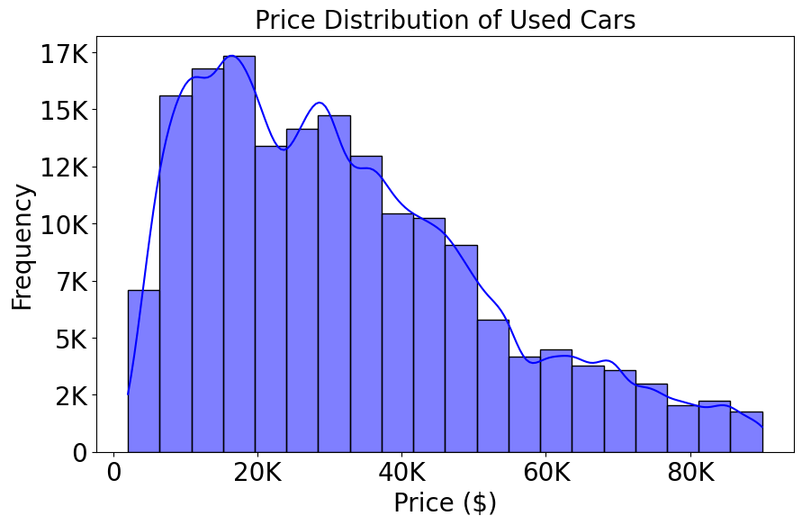
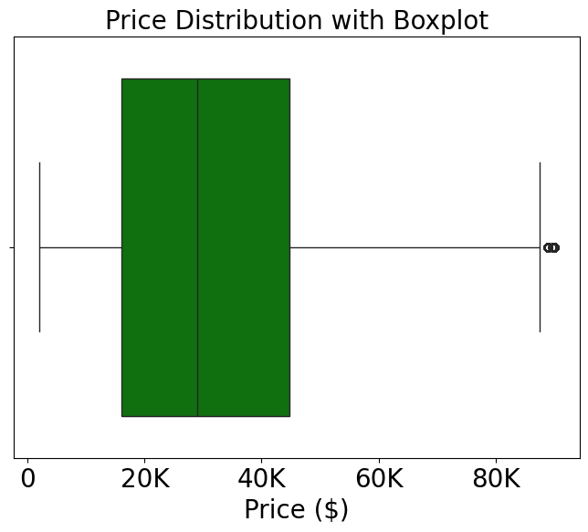
EDA Analysis
Removing outliers
Price > USD$ 90K
Notes:
Barath

Slide 6
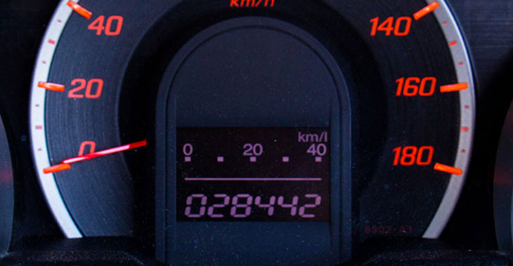
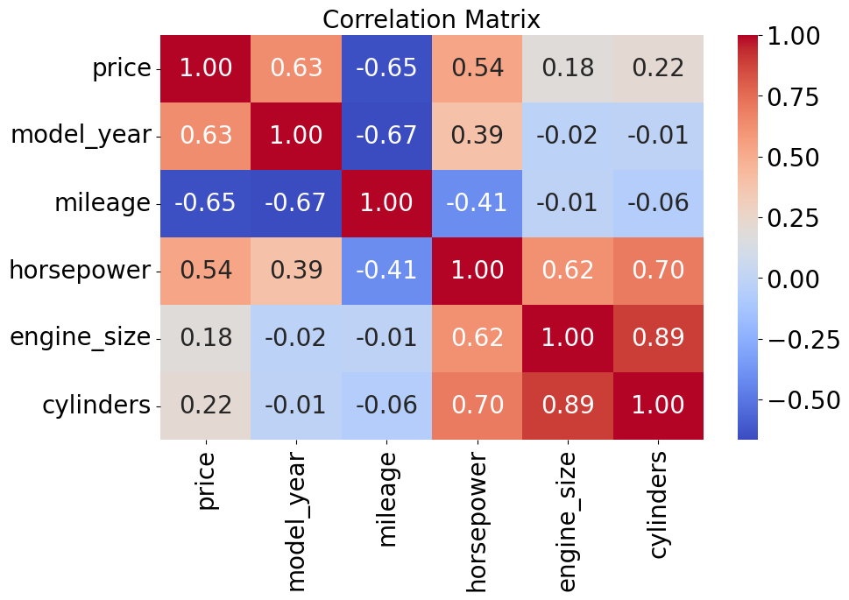


Correlation Matrix
Notes:
Barath

Slide 7

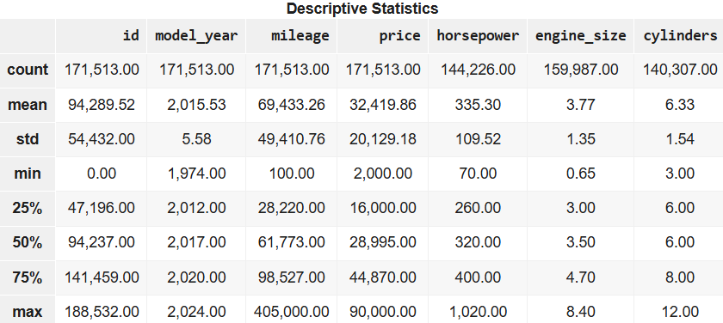
Summary Statistics
Notes:
Julio

Slide 8
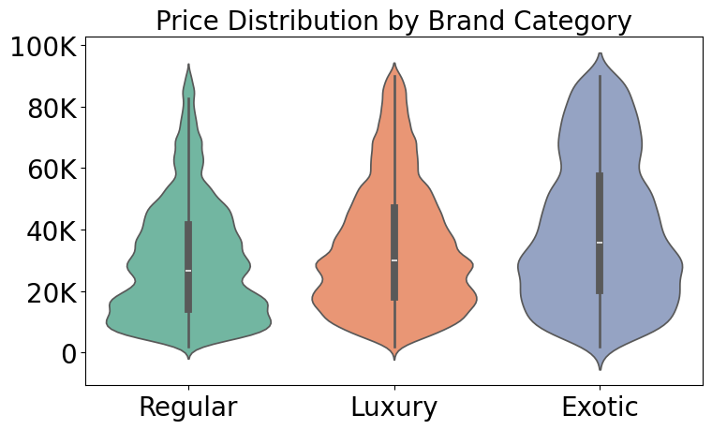
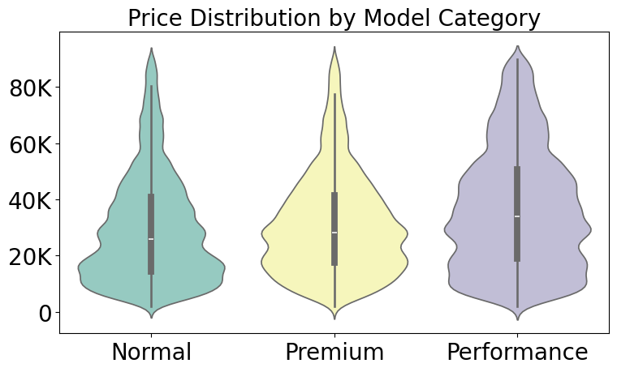
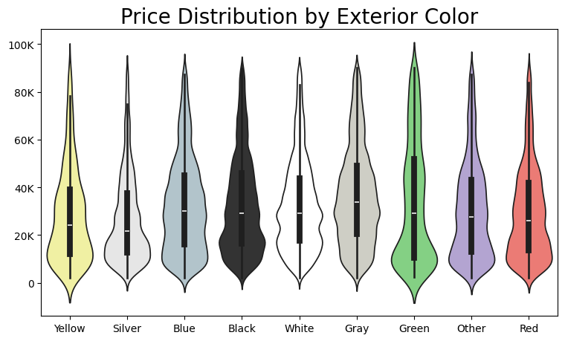
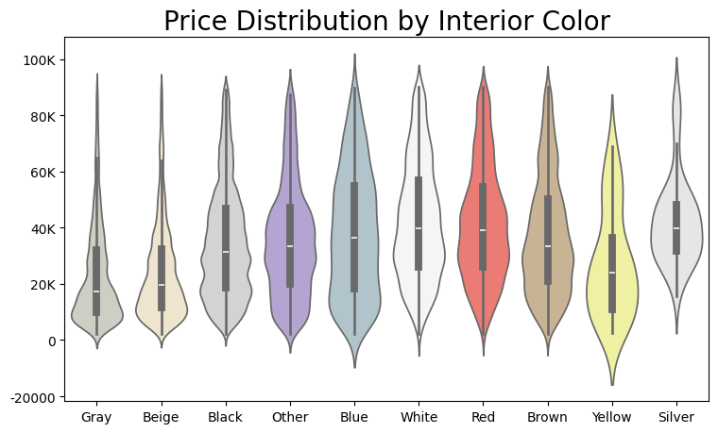
Analyzing Distribution by Categorical variables
Notes:
Barath

Slide 9
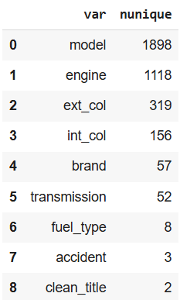
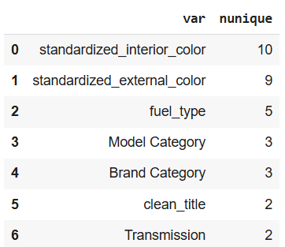
Feature Engineering
Notes:
Barath

Slide 10
Model Building : Baseline Model
Content:
Model: Ordinary Least Squares Linear Regression
Why Chosen:
Simple and interpretable model
Acts as a baseline to compare advanced models (XGBoost, LightGBM)
Performance (Cross-validation R² Score):
R² = 0.560184 approximately
Observations:
Underfitting: model unable to capture non-linear patterns
Large errors for extreme price ranges (outliers affect it)
Notes:
Barath

Slide 11
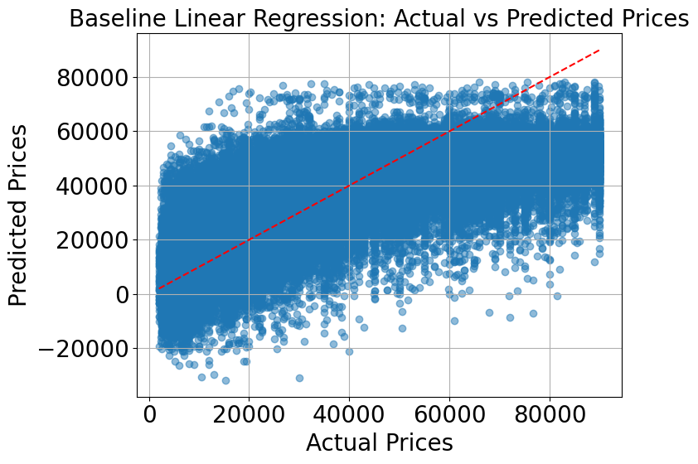
Notes:
Barath

Slide 12
Hyperparameter Tuning
Models Tuned:
Linear Regression (Baseline Model)
XGBoost Regressor
LightGBM Regressor
Tuning Method:
GridSearchCV with 5-Fold Cross-Validation
Evaluation Metric: R² Score
Notes:
Barath

Slide 13
Hyperparameter Tuning
Hyperparameters Tuned:
Linear Regression: fit_intercept, positive
XGBoost: learning_rate, n_estimators, max_depth
LightGBM: learning_rate, n_estimators, max_depth
Key Outcome:
XGBoost achieved the highest R² score (~0.637) and was selected as the final model
Notes:
Barath

Slide 14
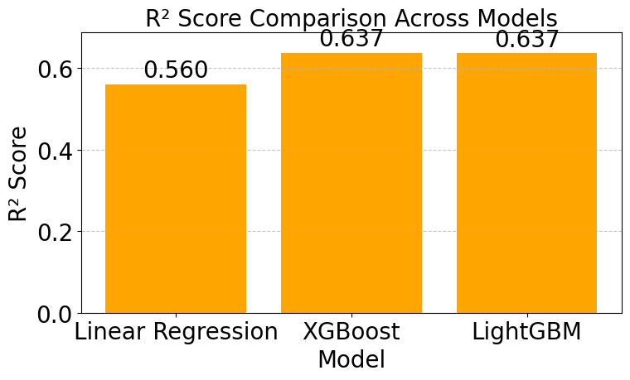
Results
Notes:
Barath

Slide 15
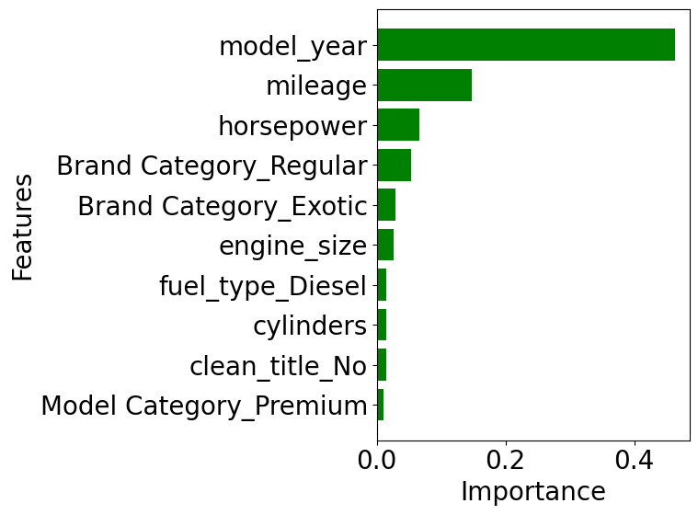
Feature Importance
Notes:
Barath

Slide 16
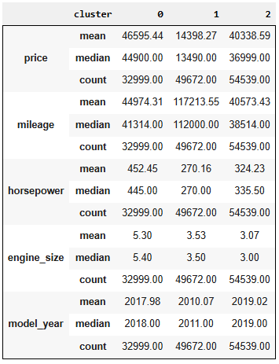
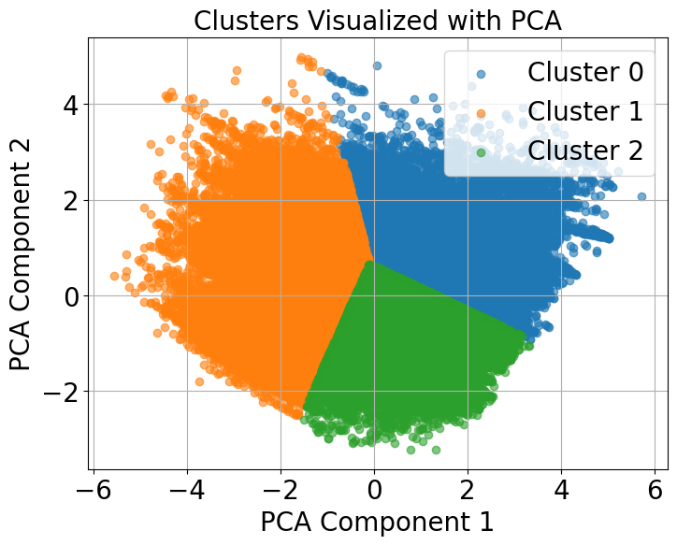
Cluster Statistics
Notes:
Barath

Slide 17
Conclusion
Key Findings:
Model year, mileage, and horsepower are the most influential factors in predicting car prices.
Exotic brand have the highest prices, followed by luxury and regular brands.
Clustering identified three distinct groups based on pricing and car features: high-end, budget, and mid-range vehicles.
Model Performance:
XGBoost achieved an R-squared value of 0.637, demonstrating strong prediction accuracy.
Feature importance showed model year as the most significant factor affecting prices.
Implications:
Insights from clustering and predictive models can guide both sellers and buyers in making informed decisions in the used car market.
Notes:
Barath

